Slide 1
MineSweeper
Studente/i
Relatore
Correlatore
Yildirim Memet Emre
Xhyra Niccolò
Giancarlo Corti
Tommaso Agnola
Corso di laurea
Modulo / Codice Progetto
Anno
Ingengeria Informatica
Software Engineering I
2024/2025
Committente
Data
Giancarlo Corti, Tommaso Agnola
02.06.2025
1
Notes:
Saluti, presenteremo…, nostril nomi, materia

Slide 2
Table of contents
Context & Motivation
Problem
Requirements
State of Art
Approach
Demo
Conclusions
2
Notes:
Parleremo dei punti,

Slide 3
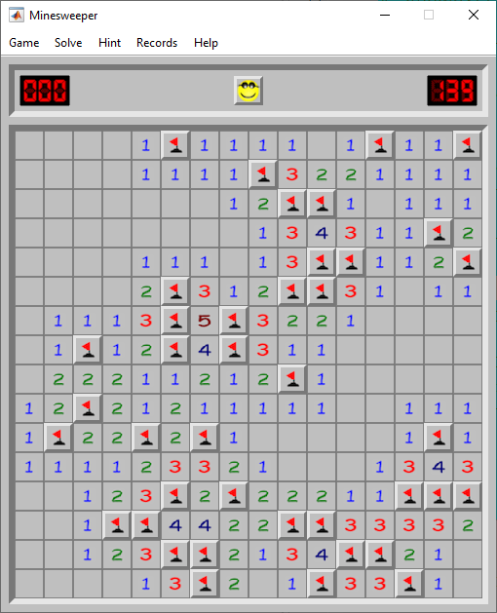
Context
Desktop GUI application development
Software Engineering Principles
3

Slide 4
Motivation
Practice Java
Object-Oriented-Programming
Interactive UI
4

Slide 5
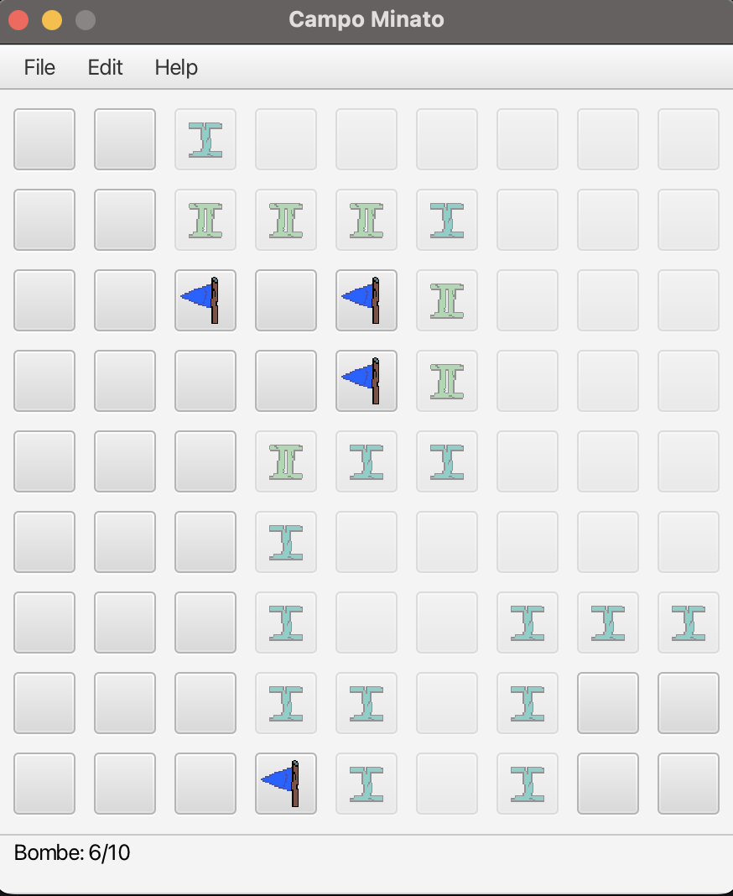
Problem
Develop MineSweeper
Allow Setting Customization
Persistence Saving-Loading
5

Slide 6
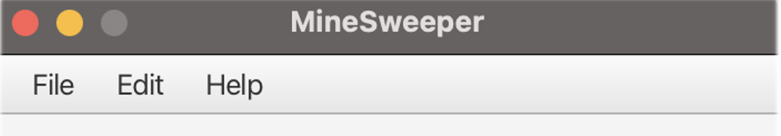
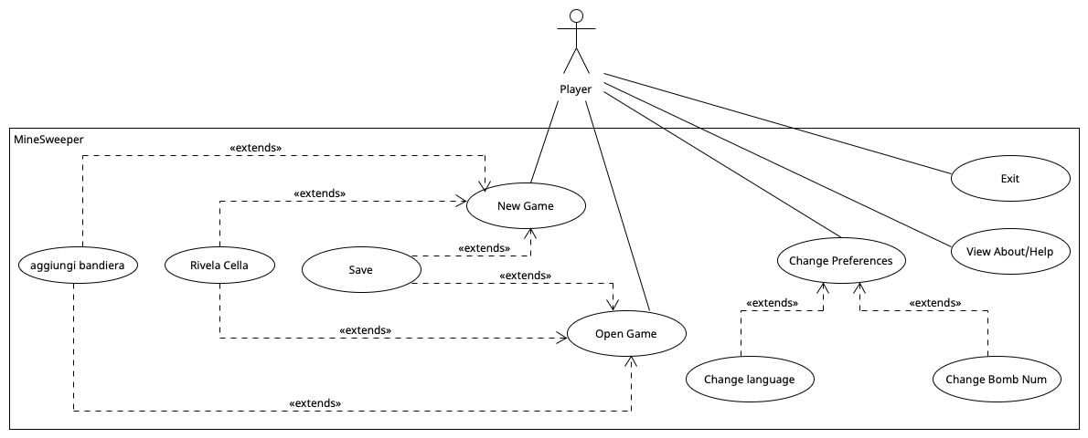
Requirements
Interactive gameplay Save and Load feature
Menu and Cold reloaded Preferences Multiple Language Support
Multi Module
6

Slide 7
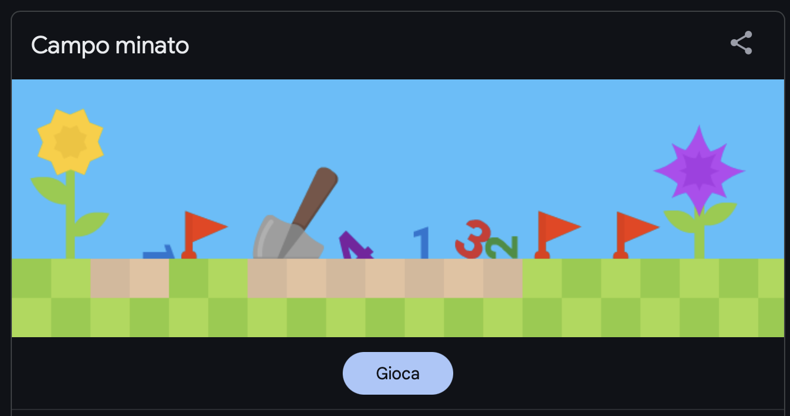
State of art
Microsoft MineSweeper 90’
Web Versions
Open source Java Versions
Modern UI Platform
7

Slide 8
Approach
Java 17
JavaFx
GitLab → version control
Maven → dependencies management
Iterative incremental

Slide 9
Approach
Model: Game Logic (GameModel)
View: UI JavaFX in FXML (MenuBar, GameBoard, Feedback)
Controller: GameController unifies game events and user input
9

Slide 10
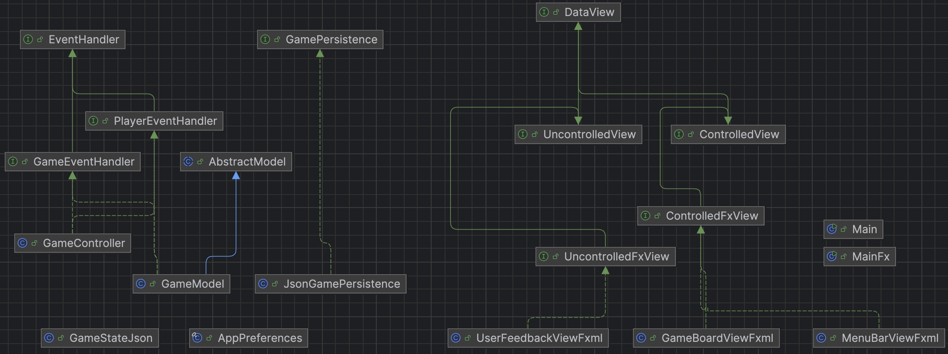
Approach
10

Slide 11
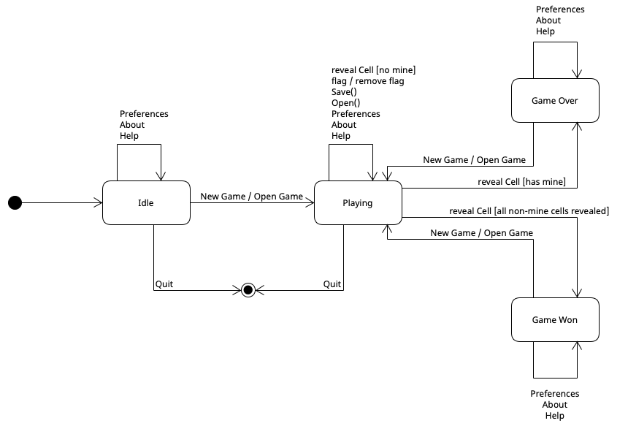
Approach

Slide 12
Demo
12

Slide 13

Conclusions
TeamWork
Upgradability
13
Notes:
Future Development: multiple language support, graphical changes, (• Mancanza di gestione centralizzata di salvataggi e preferenze cross-platform • Scarso supporto all’i18n (multilingua) • Interfaccia “classic” poco estensibile a temi e configurazioni)

